Slide 1

Transformers
Dr Maria Prokofieva

Slide 2
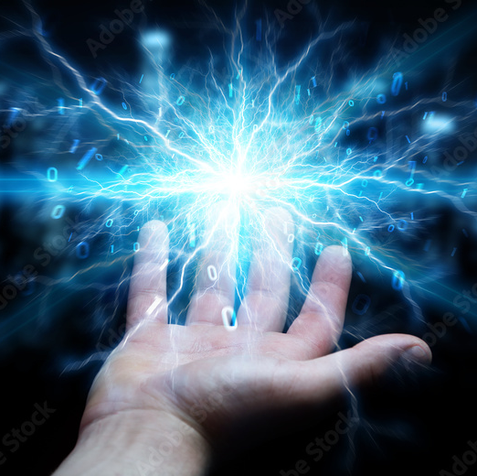
What we will cover
What are transformers
Main components of transformers
Behind the pipeline: tokenizers and models

Slide 3

What are transformers
Neural network architecture
Introduced by Google Brain in 2017 in the paper “Attention is all you need”
Main features:
Attention mechanism: replaced sequential computations in prior approaches (e.g. recurrent networks)
Reinforcement learning
Attention is all you need” paper: https://arxiv.org/abs/1706.03762

Slide 4
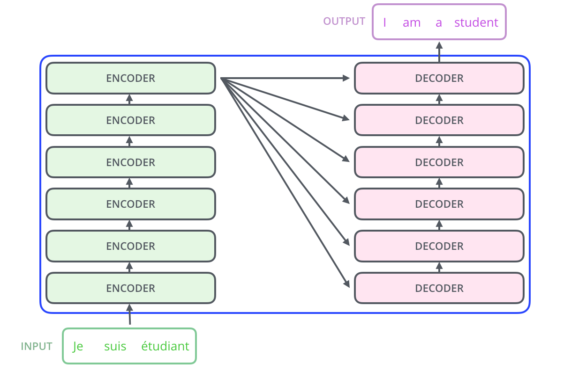
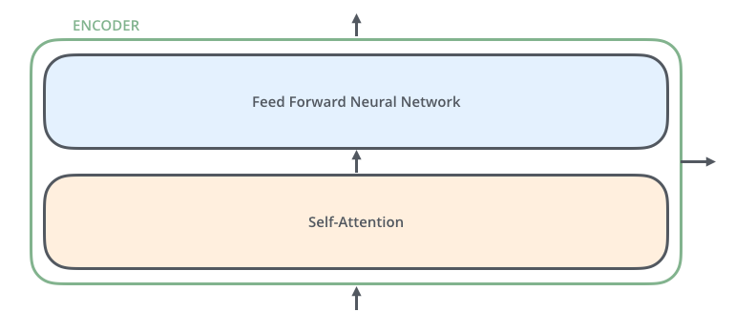
Main components
Encoder: processes the input data
Decoder: generates output sequences
Self-attention mechanism: helps models focus on relevant parts of the input
Positional Encoding: Importance in maintaining order in sequences.

Slide 5
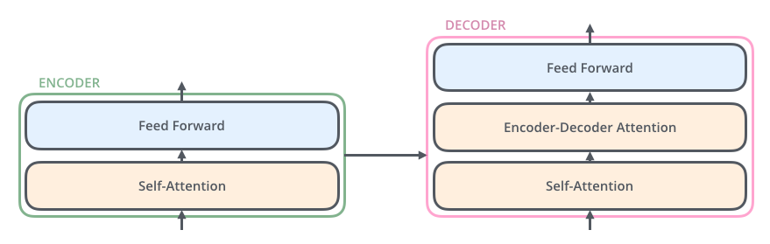

Slide 6
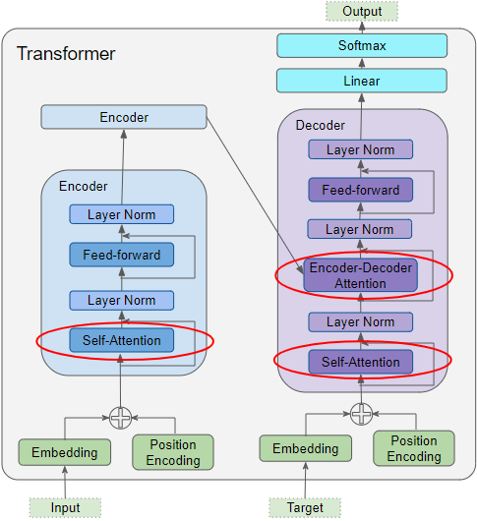

Slide 7
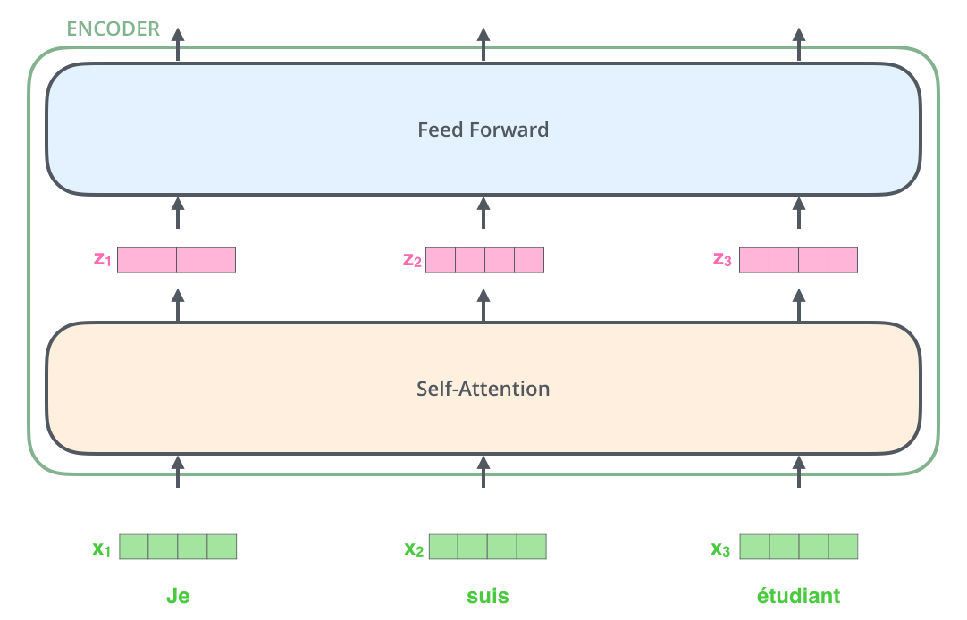

Slide 8
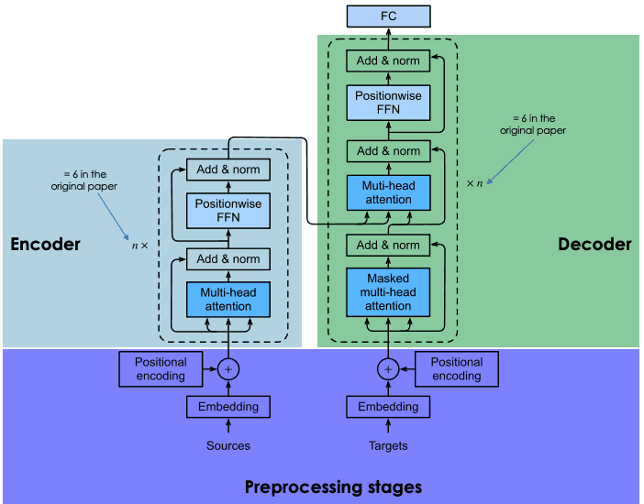
Preprocessing stage
Steps:
generation of the embeddings of the input sentence
computation of the positional vector of each word in the input sentence
Same way for the source sentence (before the encoder block) and the target sentence (before the decoder block).

Slide 9
Embedding of the input data
Steps:
tokenization
create the embedding of each individual word without paying attention to their relationship in the sentence

Slide 10
Positional encoding
Generate a context vector for each word.

Slide 11
Encoder block
Embeddings vector + its context vector= a single vector for each word
NO knowledge about the relations that existed in the input sentence

Slide 12
Multi-head attention
Attention: capture the contextual relationships existing between different words in the input sentence
Attention vector

Slide 13
Position-wise feed-forward net (FFN)
a feed-forward neural network applied to every attention vector to transform them into a format that is expected by the next multi-head attention layer in the decoder

Slide 14
Decoder block
Layers:
masked multi-head attention
multi-head attention (same as in encoder)
a position-wise feed-forward network (same as in encoder)

Slide 15
Multi-head attention layer
Splits the input into multiple smaller parts (=heads) and applies attention separately to each.
Each head independently attends to different parts of the input and captures various relationships or contexts.
The results from all heads are then combined, providing the model with a richer understanding of the input.
Benefits:
Captures Diverse Patterns
Increases Model Capacity:

Slide 16
Transfer Learning
Training from scratch is too expensive (training time)
The amount of data is not accessible
E.g. translation from one rare language to another
Solution: re-use available models
Choose the pre-trained model that is similar to your use case
Refining the input-output pair data of your target task,
Retraining the head of the pre-trained model by using your data.

Slide 17

Behind the Pipeline: Tokenizers
A tokenizer is a preprocessing tool that breaks down text into smaller units called tokens.
words, subwords, or even individual characters
Each token is then converted into a numerical ID that the transformer model can understand and process.
Different types of tokenizers (WordPiece, BPE, Unigram, SentencePiece)
How tokenizers prepare text for transformers

Slide 18
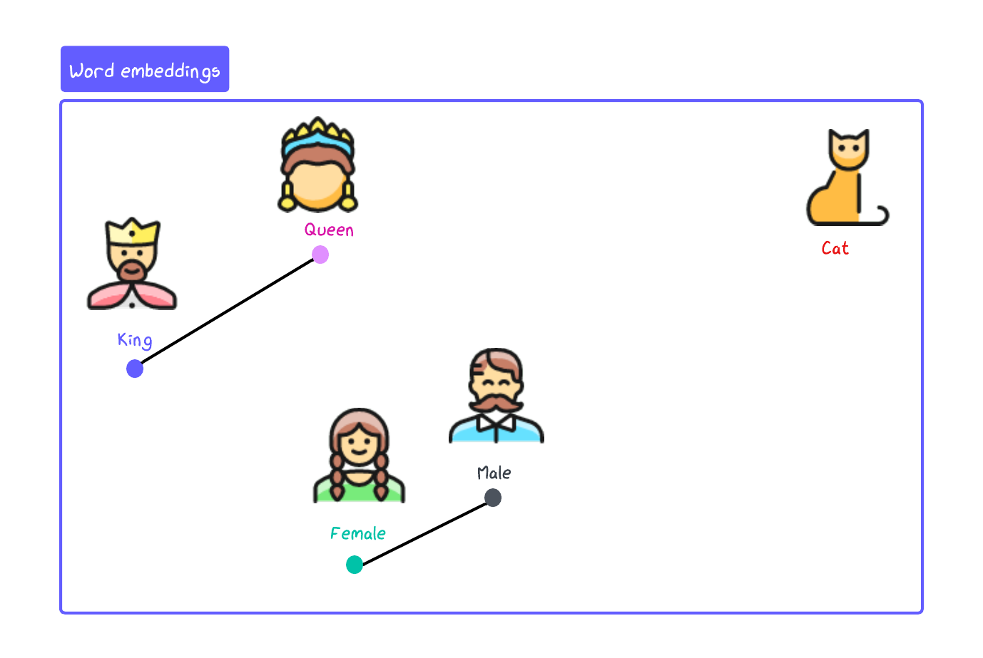
Word embeddings

Slide 19

Let’s practice

